Slide 1
DDS – For Live Session Unit 3
Andrew Leppla
*See Notes section below slides for R code

Slide 2
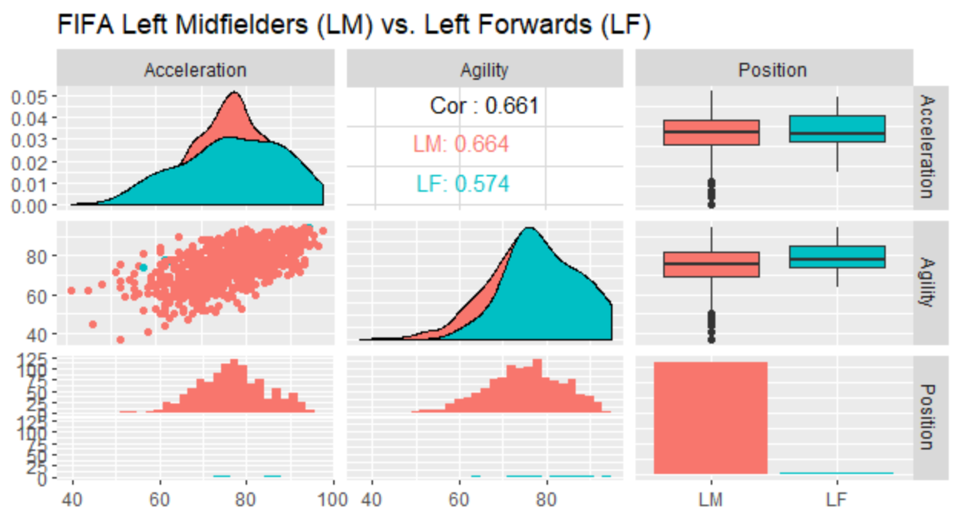
There are almost 10X more left mid-fielders than left forwards which makes any comparisons difficult and questionable. Mid-fielders may be slightly more agile.
Notes:
#Filter data for LM and LF and remove residual factor levels
fifa1 = fifa %>% filter(Position == "LM" | Position == "LF")
fifa1$Position=factor(fifa1$Position,levels=c("LM","LF"))
#Ggally
fifa1 %>% filter(Position == "LM" | Position == "LF") %>% select(Acceleration,Agility,Position) %>% ggpairs(aes(color=Position)) + ggtitle("FIFA Left Midfielders (LM) vs. Left Forwards (LF)")

Slide 3
Six Step Hypothesis Test: Agility of LM vs. LF (Unequal Variance)
H0: µ_{LM} = µ_{LF} Ha: µ_{LM} ≠ µ_{LF}
t_crit (0.975,14.48) = 2.14
t_value = 2.01
P(t_value > t_crit) = 0.063
Do Not Reject H0
In conclusion, there is not sufficient evidence to suggest that the mean agility of left mid-fielders (LM) is different than left forwards (LF) (p = 0.063, Welch’s 2-sided 2-sample t-test). The 95% confidence interval for the mean difference in Agility (LF-LM) is [-0.27,8.98].
Notes:
#Equal Variance
t.test(data=fifa1,Agility~Position,var.equal=T)
t.crit=qt(0.975,1108)
t.crit
#Unequal Variance (Welch)
t.test(data=fifa1,Agility~Position,var.equal=F)
t.crit.Welch=qt(0.975,14.48)
t.crit.Welch

Slide 4
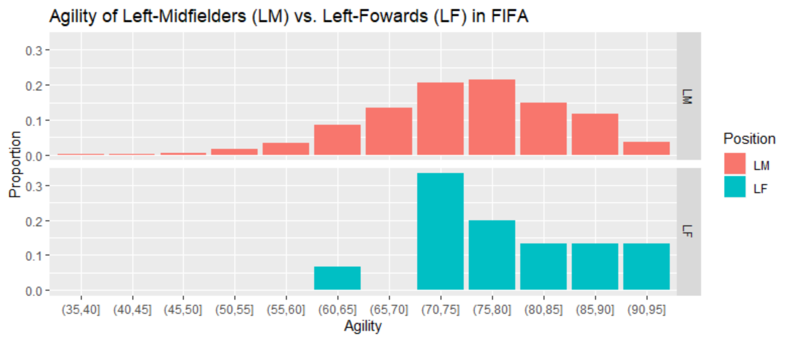
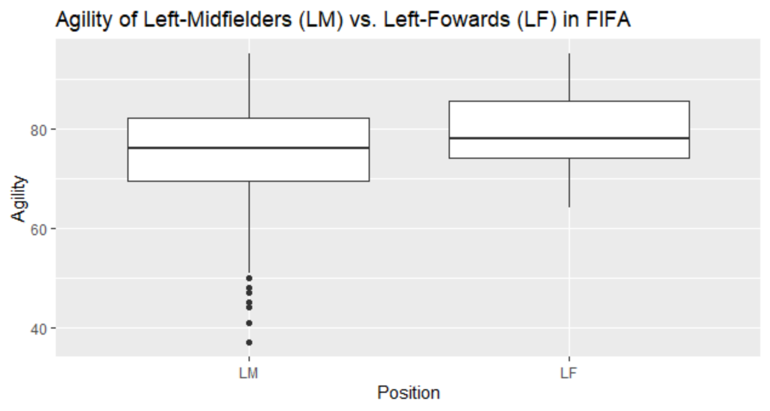
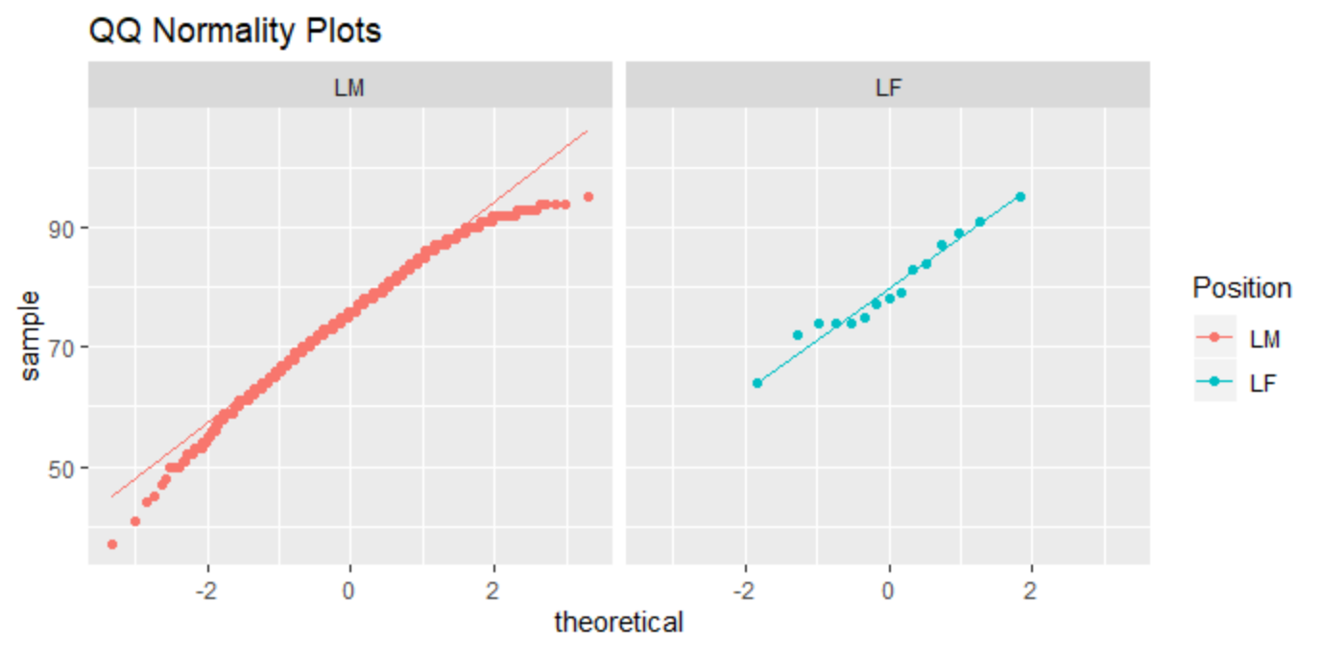
Assumptions are met for Welch’s 2-sample t-test: Visual evidence of unequal variance is accounted for in this test. The sample size of LM (n=1095) is sufficient to invoke the central limit theorem for normality of the mean.
Notes:
#Boxplot
fifa1 %>% ggplot(aes(x=Position,y=Agility)) + geom_boxplot() + ggtitle("Agility of Left-Midfielders (LM) vs. Left-Fowards (LF) in FIFA") + ylab("Agility")
#Scaled Histograms
fifa1$cut_Agil = cut(fifa1$Agility, breaks = c(40,45,50,55,60,65,70,75,80,85,90,95,100))
fifa1 %>% ggplot(aes(x=cut_Agil,y=..prop..,group=1,fill=Position)) + geom_bar() + facet_grid(rows=vars(Position)) + ggtitle("Agility of Left-Midfielders (LM) vs. Left-Fowards (LF) in FIFA") + xlab("Agility") + ylab("Proportion")
#QQ Plots
fifa1 %>% ggplot(aes(sample=Agility,color=Position)) + geom_qq() + geom_qq_line() + facet_grid(~Position) + ggtitle("QQ Normality Plots")

Slide 5
EDA
2 continuous variables: HeadingAccuracy, Finishing
2 categorical variables cut from continuous: Jersey.Number, Jumping
Is there any visual evidence to support the notion that “Number 9” on teams is typically thought of as high-scoring with headers?

Slide 6
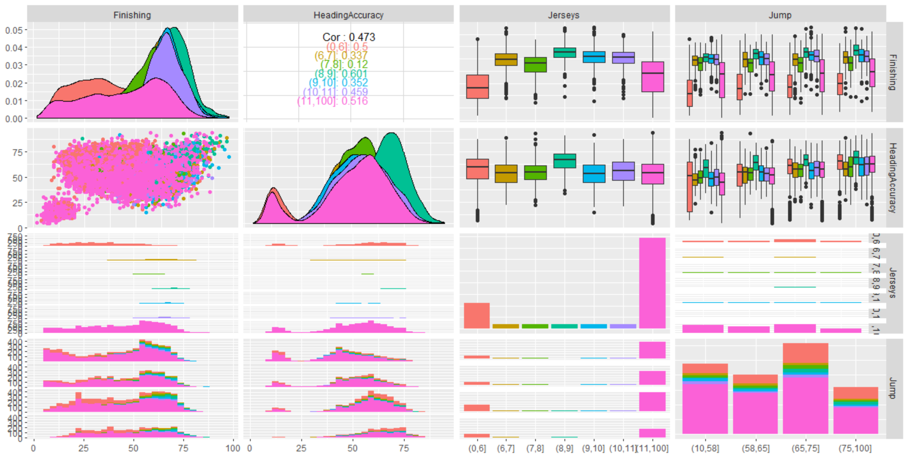
Higher Finishing (Scoring) is associated with Jersey Numbers 7-11 which are typically forwards. Number 9s have the highest Heading Accuracy.
Notes:
#Select 2 continuous and 2 cut categorical variables
fifa2 = fifa %>% select(Jersey.Number, Finishing,HeadingAccuracy,Jumping)
#Cut Jumping variable into quartiles from summary data
summary(fifa2$Jumping)
fifa2$Jump = cut(fifa2$Jumping, breaks=c(10,58,65,75,100))
Examine #9 and other numbers
fifa2$Jerseys = cut(fifa$Jersey.Number, breaks=c(0,6,7,8,9,10,11,100))
#Explore the data
fifa2 %>% filter(!is.na(Jerseys)) %>% select(Finishing,HeadingAccuracy,Jerseys,Jump) %>% ggpairs(aes(color=Jerseys))

Slide 7
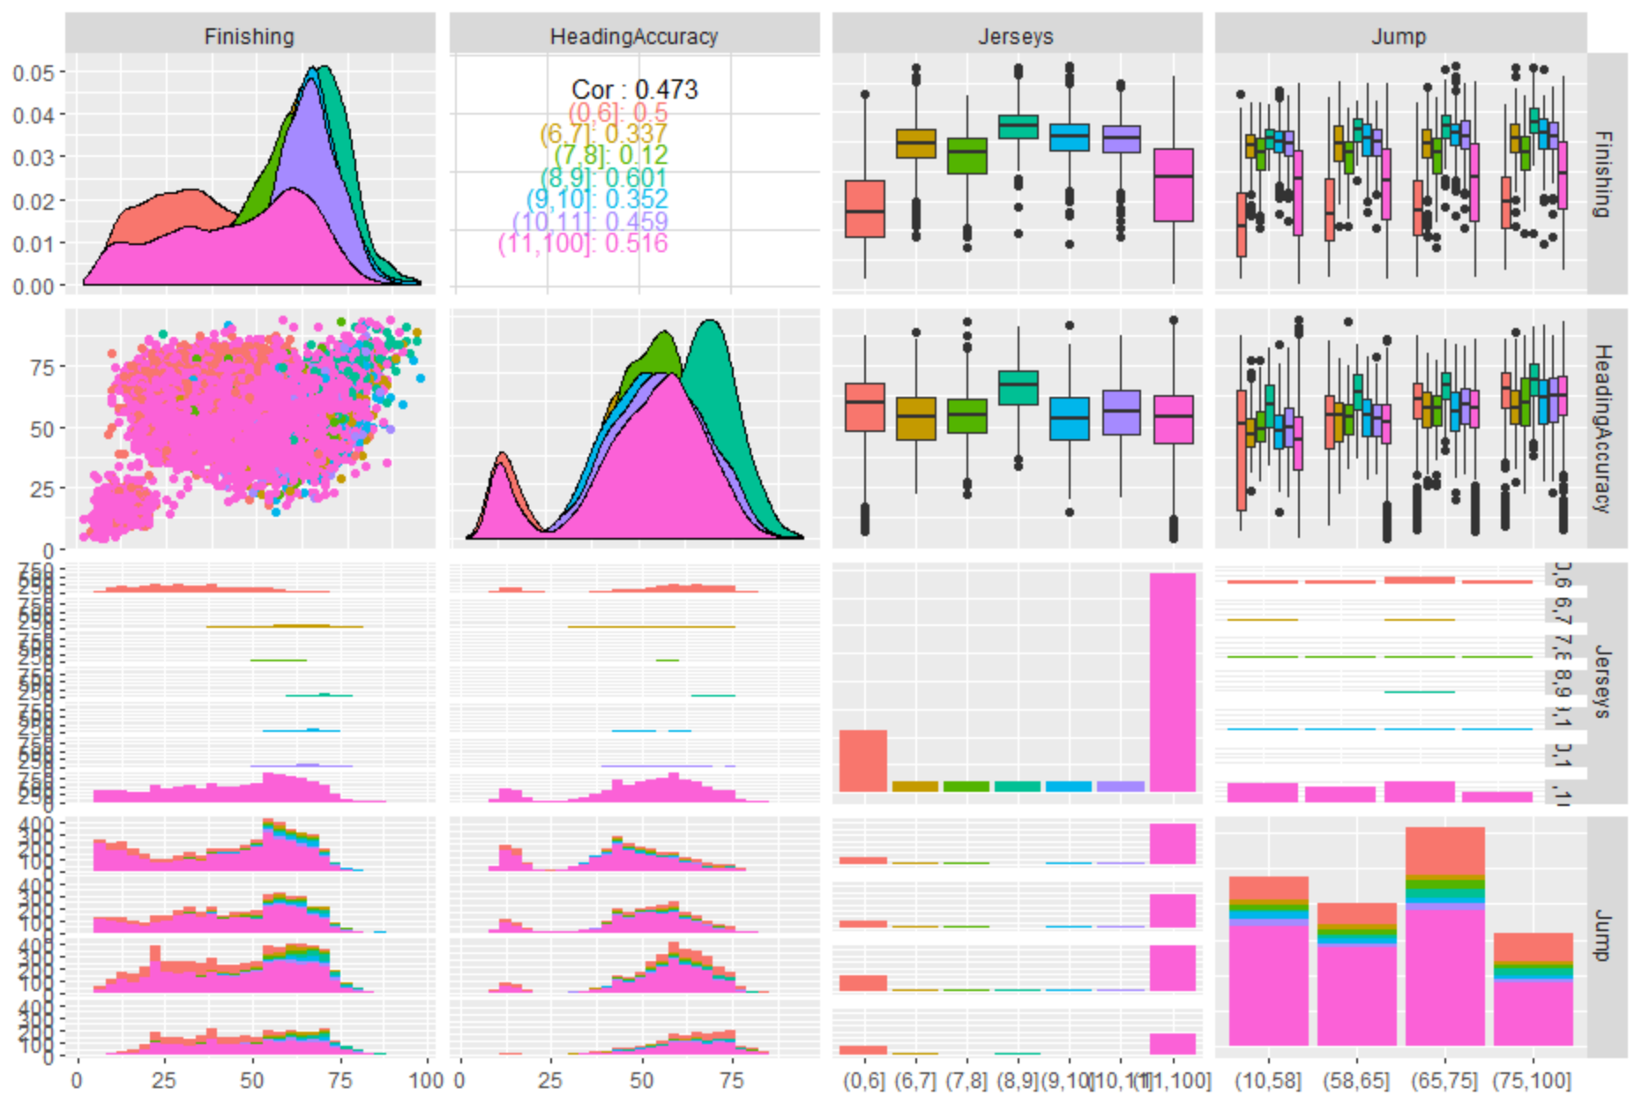
Heading Accuracy looks bimodal due to a large number of low outliers (defenders?). This also appears as a distinct cluster in Heading Accuracy vs. Finishing.

Slide 8
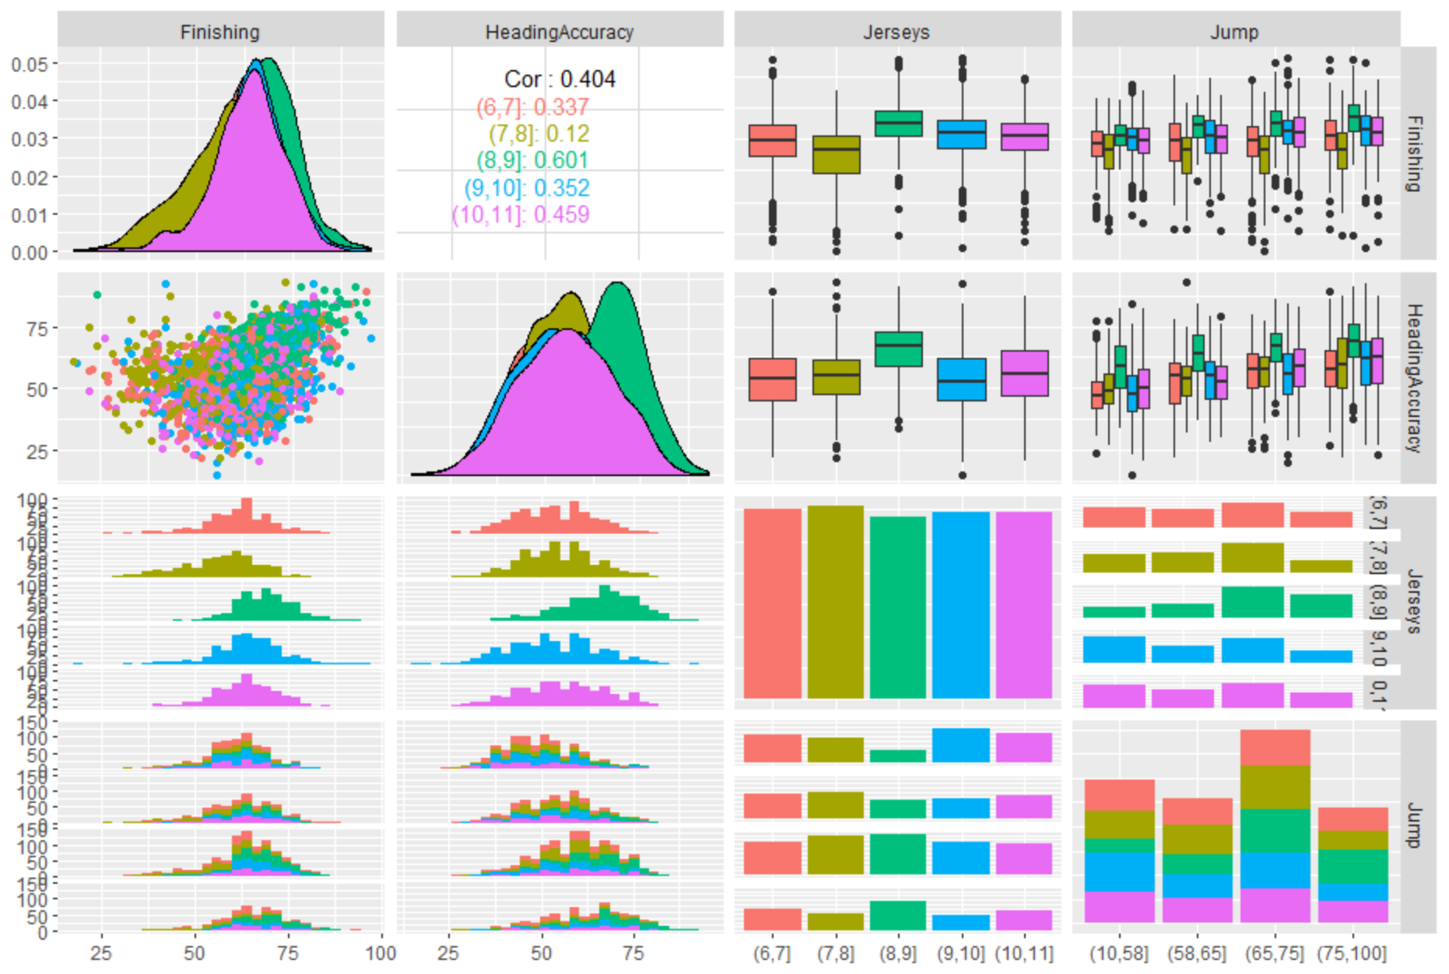
Clear evidence that Number 9s have the “best-of-the-best” Heading Accuracy and Finishing. Filtered for Jersey #s 7-11 which eliminated the cluster of low Finishing & low Head.Acc.
Notes:
#Narrow in on high performing jersey numbers
fifa2$Jerseys = cut(fifa$Jersey.Number, breaks=c(6,7,8,9,10,11))
fifa2 %>% filter(!is.na(Jerseys)) %>% select(Finishing,HeadingAccuracy,Jerseys,Jump) %>% ggpairs(aes(color=Jerseys))

Slide 9
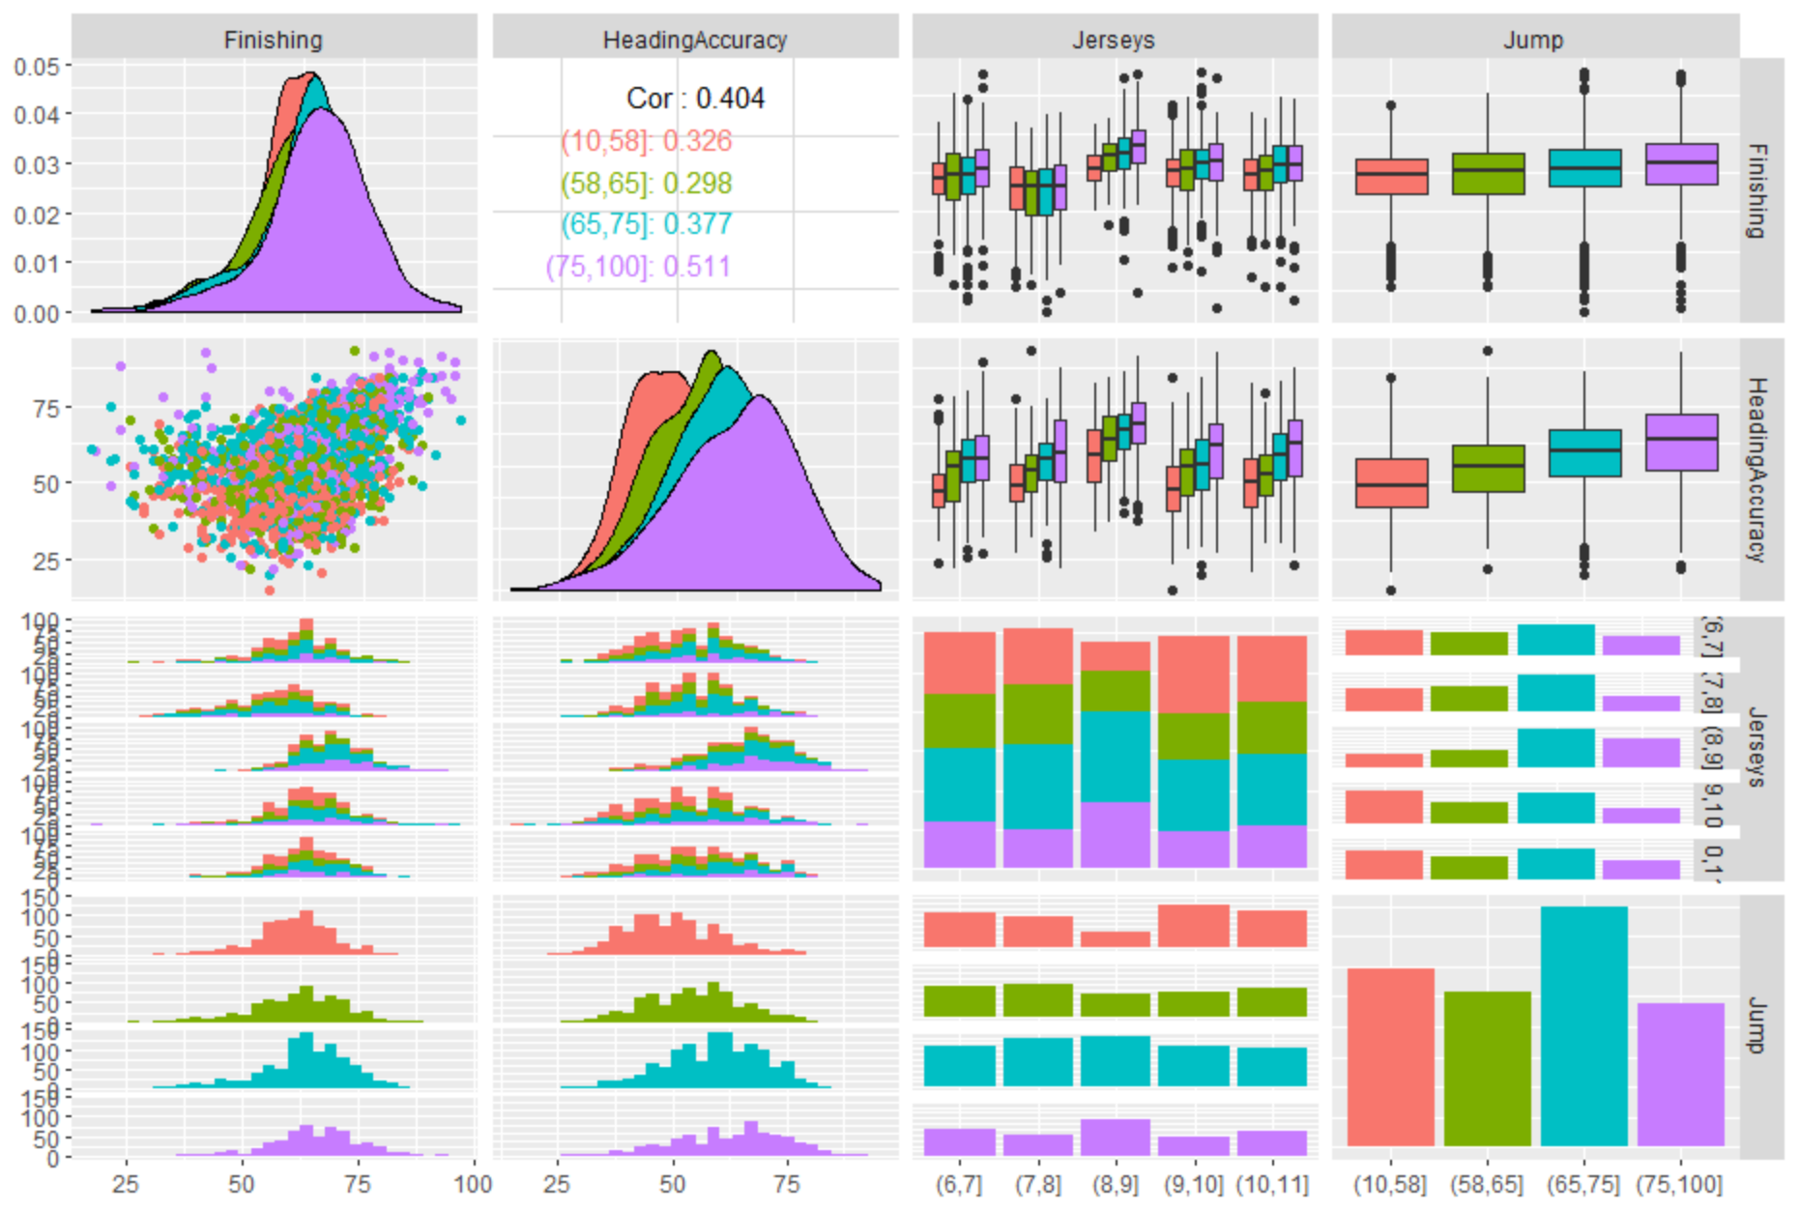
Number 9s appear to have the highest Jump scores which are associated with the highest Heading Accuracy and Finishing. Heading Accuracy vs. Finishing may have some curvature.
Notes:
#Look at Jump more closely
fifa2 %>% filter(!is.na(Jerseys)) %>% select(Finishing,HeadingAccuracy,Jerseys,Jump) %>% ggpairs(aes(color=Jump))

Slide 10
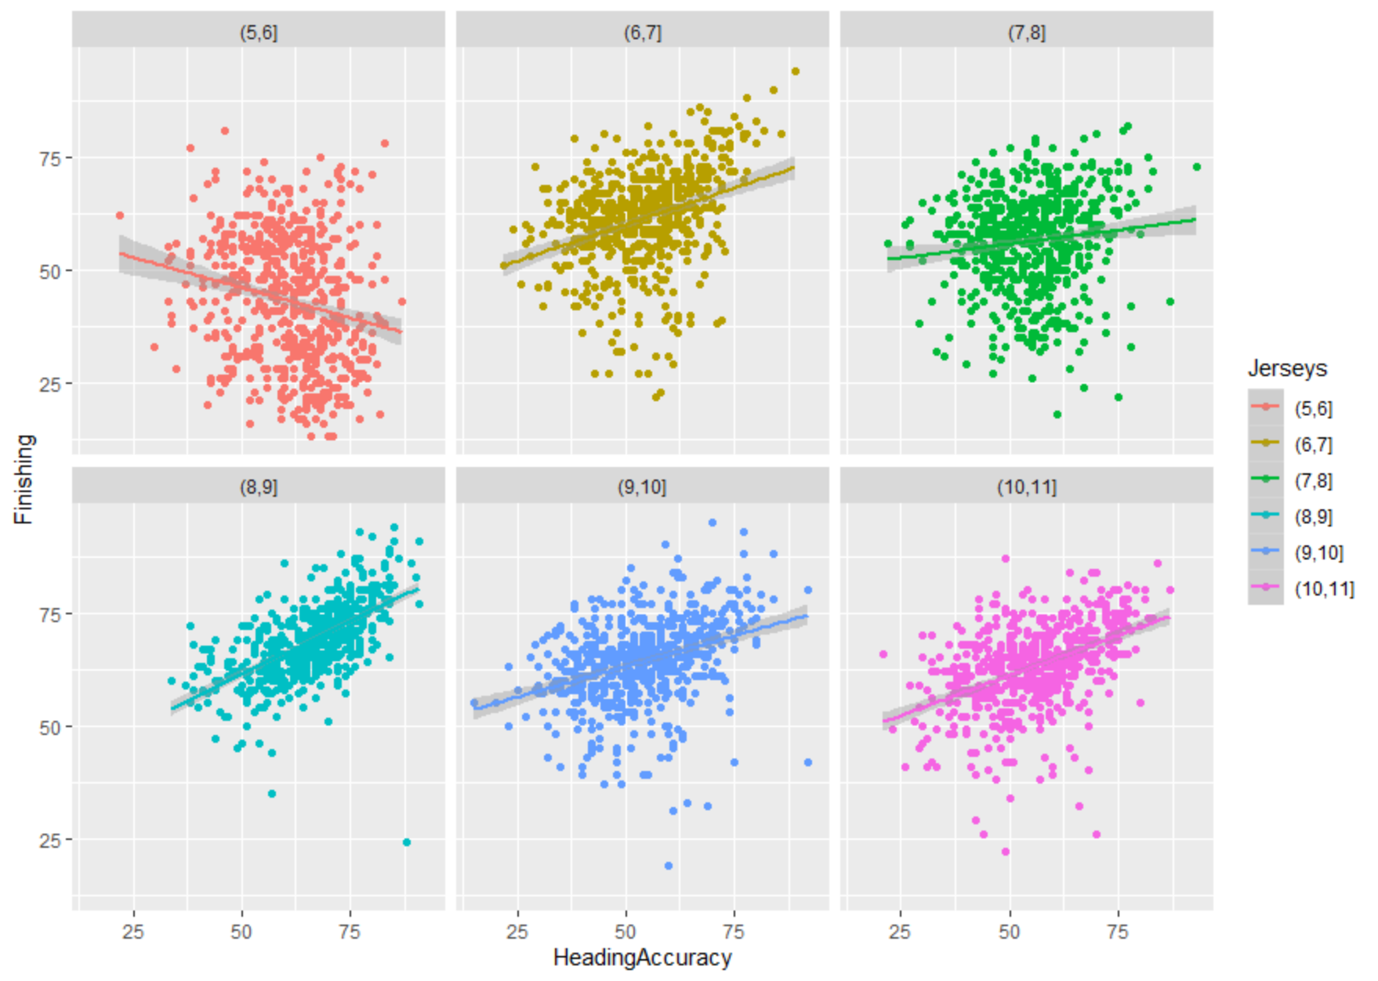
No curvature when split by jersey. Number 9s have the strongest relationship between Heading Accuracy and Finishing, but there is an outlier with higher leverage (K. Papadopoulos, Center Back, Club “Hamburger SV”.
Notes:
fifa2 %>% filter(!is.na(Jerseys)) %>% ggplot(aes(HeadingAccuracy,Finishing,color=Jerseys)) + geom_point() + geom_smooth(method="lm") + facet_wrap(~Jerseys)
outlier9 = fifa %>% filter(Jersey.Number==9 & HeadingAccuracy>75 & Finishing<25)
outlier9

Slide 11
Takeaways and Questions
Takeaways
Filtering data does not eliminate empty factor levels
ggpairs is really useful if you don’t have too many variables or too many factor levels to explore
Ctrl-F is my best friend for finding a piece of code from the Rmarkdown files
Questions
Is there a good resource that clearly lays out all of the options embedded within ggplot?

